Slide 1


Predicting Flight Delays
BA476 B1 Team 6: Uriel Choi, Zac Held, Francisco Moguel, Vivian Shen, Albert Zhang
By predicting the delay duration of a flight, the goal is to help airlines, airports, and passengers better manage their schedules and minimize the impact of disruptions.
This predictive model can be used to:
Improve operational efficiency
optimize resource allocation
enhance customer satisfaction
by providing more reliable delay estimates.
Notes:
Uriel

Slide 2
Dataset & Variables
Source: US Department of Transportation – Bureau of Transportation Statistics, August 2019 - August 2023
3 million observations, and 30 variables
Includes all U.S. domestic flight data from 2019 - 2023
The columns include both categorical and numerical data
Categorical data includes the origin city, destination city, airline carrier, etc.
Numerical data includes delay minutes by diverse factors and specifying if the flight was diverted (on a 0-1 indicator)
Outcome variable: ARR_DELAY
Difference in minutes between scheduled and actual arrival time.
Predictor variables:
flight date, airline, origin and destination city, airtime, distance, and delays in minutes due to carrier, weather, national air system, security, and late aircraft.
Notes:
Francisco, Vivian

Slide 3
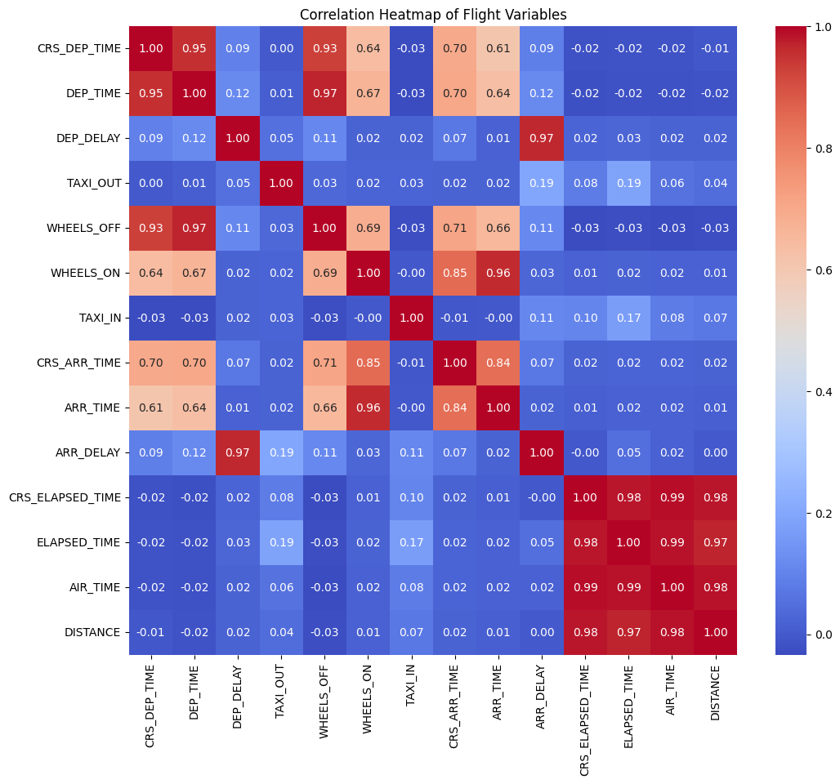
Trends
and
Relationships:
Visualizations
Notes:
Zac

Slide 4
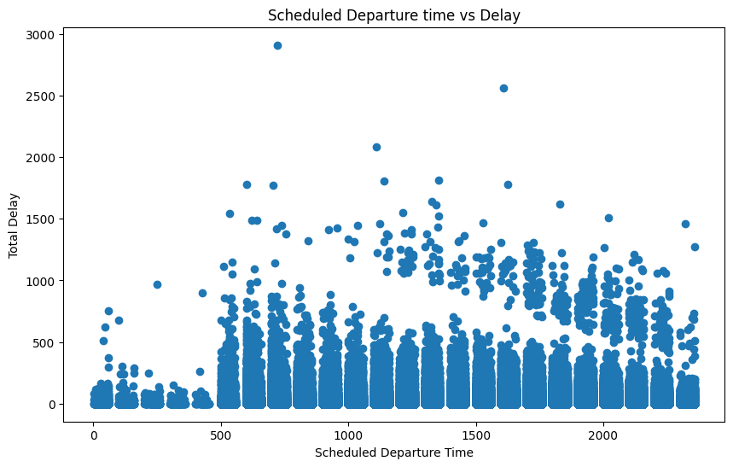

Slide 5
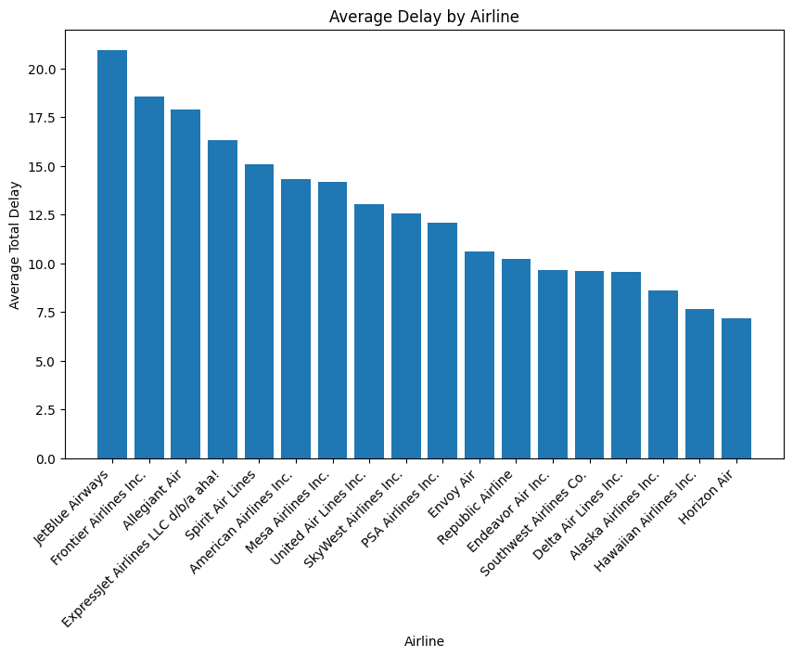
Notes:
Zac

Slide 6
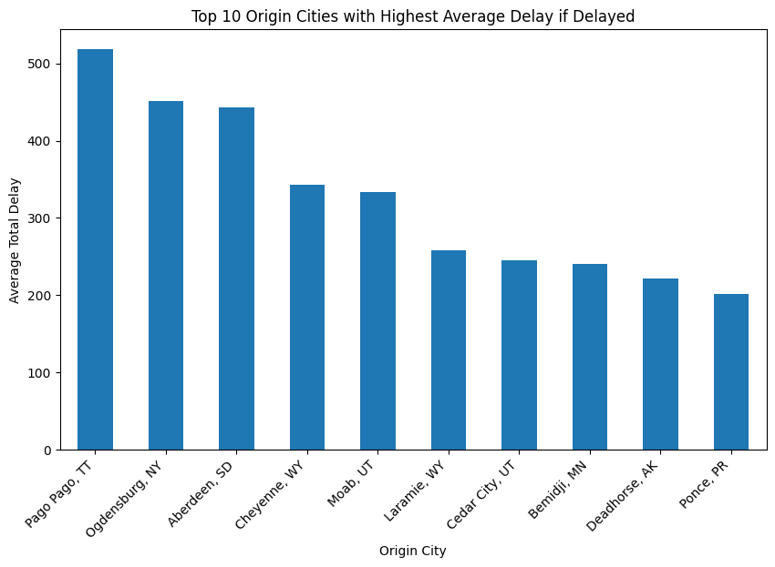
Notes:
Albert

Slide 7
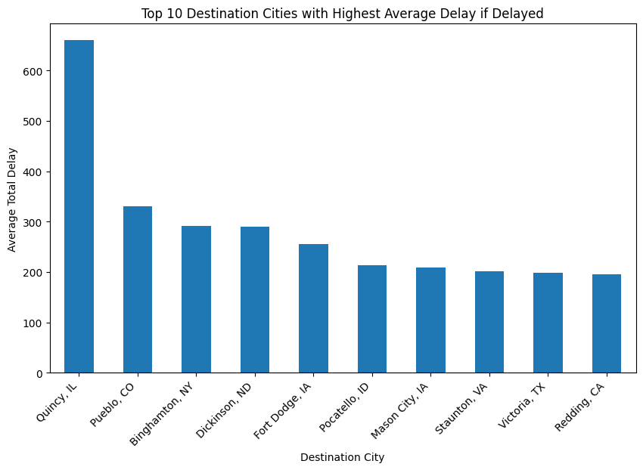
Notes:
Albert

